Slide 1
Lessons on Leadership
…and what I’ve learned during the pandemic
Lt Col Jim Cunningham
19 Apr 2022

Slide 2
Who I Am
Prior Enlisted, 27.5 years total
Budget, Cost & Financial Services
Sq/CCx2, AFOTEC Comptroller, AFMC/FMAO, SAF/FMB Exec
Security Forces, AFROTC Instructor & DFM&CS

Slide 3
Who I Am
From Lakewood, WA
Married to my high school sweetheart
Camping, movies, theme parks and travel
Huge sports fan
Passionate coach
Youth, middle school and high school
Air Force teams

Slide 4
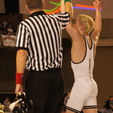
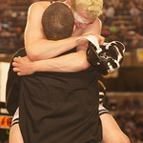
Coach Jim

Slide 5
Leadership Philosophy
All about building a culture…your team knows what's important to you
Combat Comptrollers…it’s the big picture
Outstanding customer service…we are here for them
Academics…at every level
Courageous leadership…it’s usually hard
Have a positive attitude…it carries the day!
Jump at opportunities to support your Airmen…you are here for them
Inclusive leadership…helps build trust…we are better together
Make it fun!

Slide 6
Pandemic Leadership
Change is hard, really hard for some
Is telework a success?
Did it add flexibility?
Innovation?
Accountability is tough
Be responsive!
Is the job getting done?
Are you still providing Outstanding Customer Service?
Reduced hours, no walk-ins, responsiveness
Building a culture
Recent experience…OAR/OAW

Slide 7
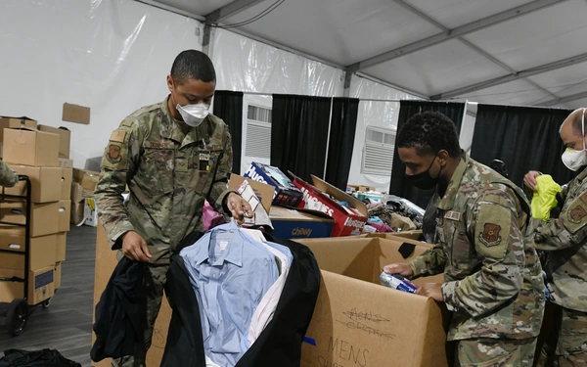
Operation Allies Refuge/Welcome
Own the prep…its not about getting ready, its about staying ready
“Be an athlete”
Its more valuable to be an athlete on the field, than a position player on the bench
Multi-Capable Airmen/Agile Combat Employment
“Who’s been a squadron commander”
We had no playbook
No training when we arrived
It was go-time!

Slide 8
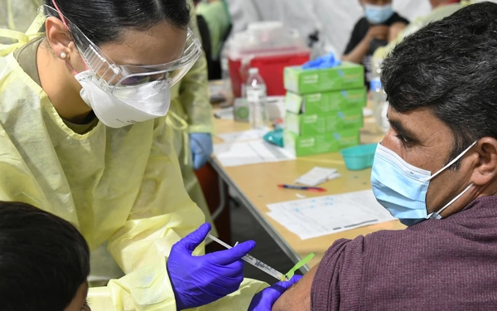
Operation Allies Refuge/Welcome
Started w/50, working 12-14 hour shifts, 24-hours a day operation
Grew to 300 multi-agency/multi service
In-processed 15,000 refugees
Immunizations
DHS/DoS Citizenship interviews
Clothing and initial supplies
Lodging…believe it or not was the hardest part

Slide 9
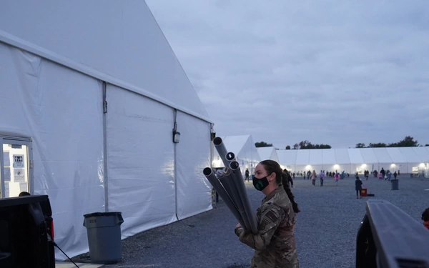
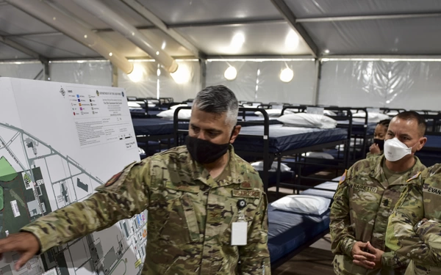
Lodging

Slide 10
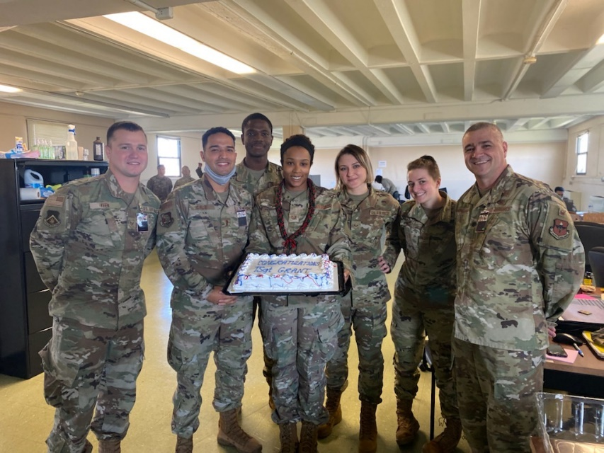
Task Force Liberty/J8
OHDACA funding?
AFCAP contract
Undefinitized contract award…$1.4B ceiling
GPC purchases
Same old questions
Water
Coins
Some new ones
Wheelchairs
NFL $25K donation

Slide 11
Final Thoughts
We have the world’s greatest Airmen…take every chance to thank them
“No one cares how much you know, until they know how much you care”
Every day is a job interview
Establish your credibility…and then maintain it
Any Airman, Any AFSC

Slide 12
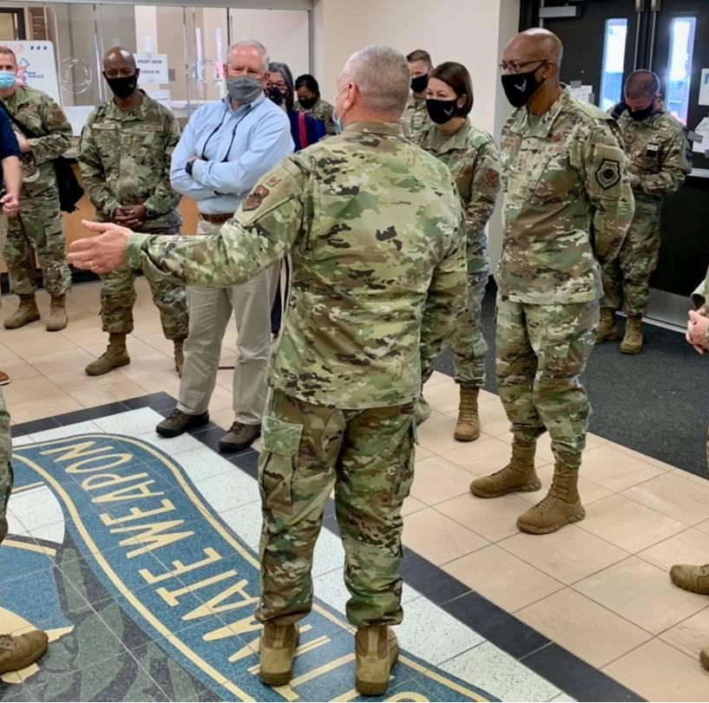
First Stop to Liberty Village
Tour guide…over 50 VIP visits
Secretary of Defense
Chairman, Joint Chiefs of Staff
SecAF, CSAF and CMSAF
2 Combatant Commanders
2 MAJCOM/CCs
3 CODELs, Mayor, Gov
…
And…Prince Harry and Meghan!

